Slide 1
Effects of Cord clamping in preterm infants
Joshua Moe, Sonu Ojha, Bryan Quintana, Kel Amede, Nicoletta sheppard

Slide 2

Intro/data fetching

Slide 3
Data process
Dataset consists of 353 rows and 36 columns.
Should ‘died’ or ‘survwithoutmajormorbidity’ be the ‘target’?
Dropped columns 'hct1224' and 'hct1236’ then dropped any rows containing any NaN value(s)—preserved 310 rows of data. (not dropping the two column results in losing over a third of our data).
After cleaning the dataframe, no entries where a subject died remained. Even if we didn’t drop columns 'hct1224' and 'hct1236’, less than 5% of the entries had subjects who ‘died’. Went with ‘survwithoutmajormorbidity’ for a better target split of close to 4/1 (yes/no) ratio.

Slide 4
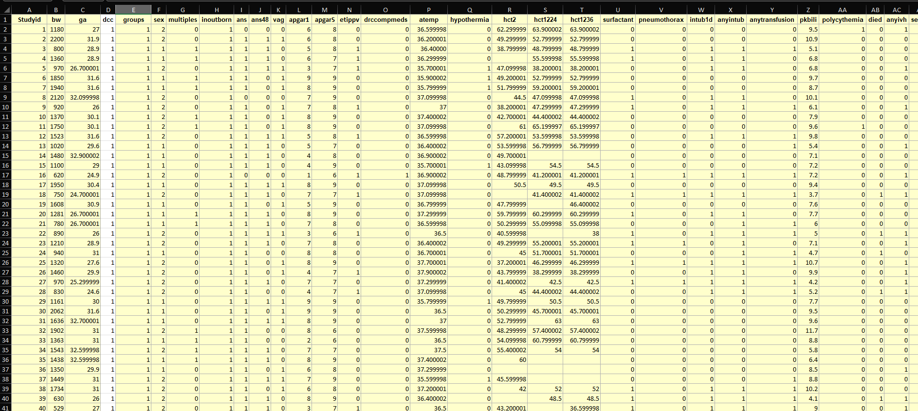
visual

Slide 5
Machine learning model
Logistic Regression Classification Module.
Thirty-Three columns as Features. The ‘survwithoutmajormorbidity’ column as the Target.
Procedure:
Train-test-split the data (after ETL).
Scale the features with StandardScaler().
Create a Logistic Regression model (random_state=1)
Fit the model
Make prediction and Evaluate accuracy of predictions made.

Slide 6
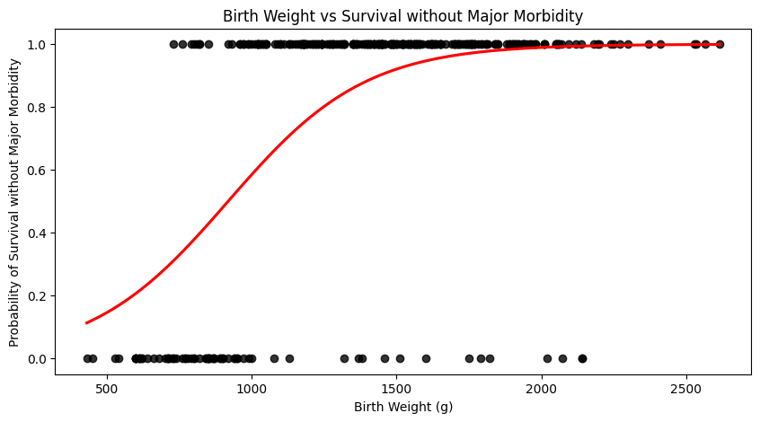
visual

Slide 7
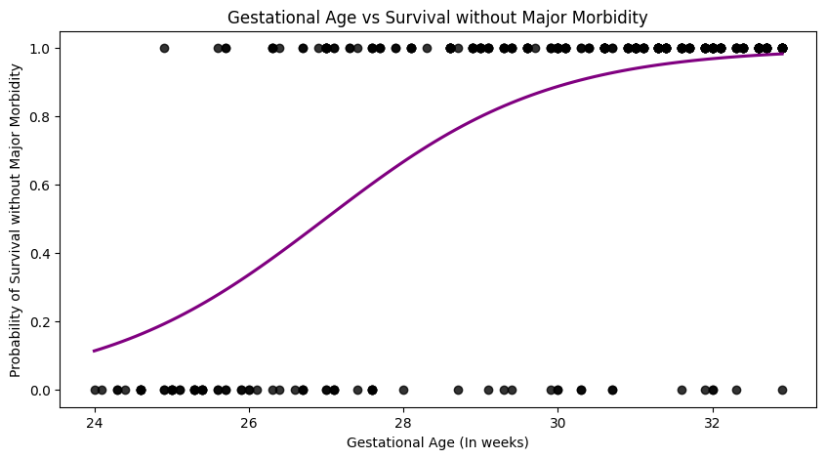
visual

Slide 8
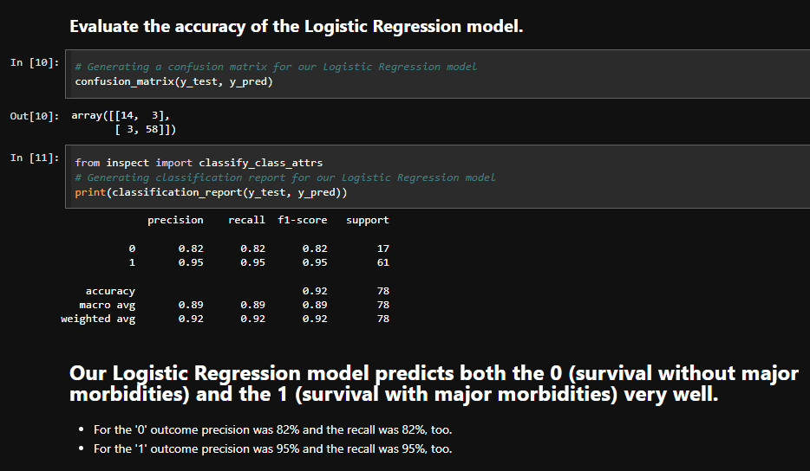
Testing/documentation
Confusion Matrix
…
…
Classification Report
…
…

Slide 9
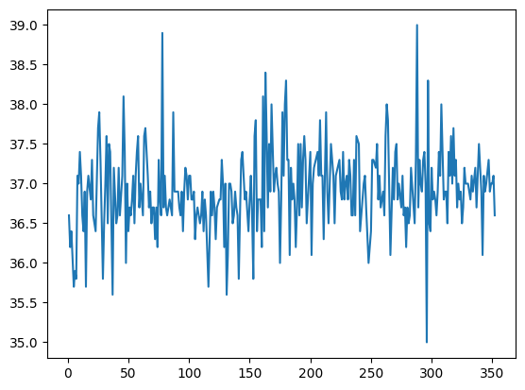
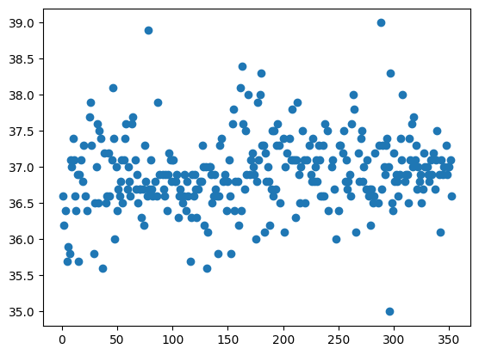
visual

Slide 10
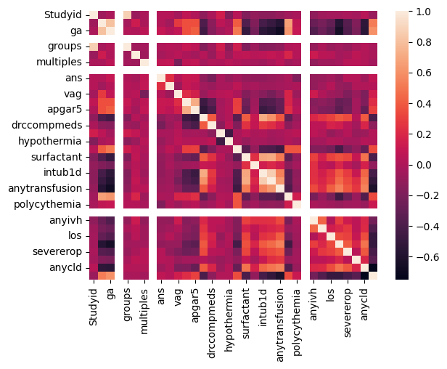
visual
Text box….

Slide 11

Summary of findings
Summary Point
Point 1
Point 2
Point 3
…

Slide 12
Work cited
Song, Dongli; Jegatheesan, Priya; DeSandre, Glenn; Govindaswami, Balaji (2016). Data from: Duration of cord clamping and neonatal outcomes in very preterm infants [Dataset]. Dryad. https://doi.org/10.5061/dryad.4q3d3

